Slide 1

Hi,
I am SUMAIYAH

Slide 2
Problem Solving Approach
Sumaiyah Zahid

Slide 3
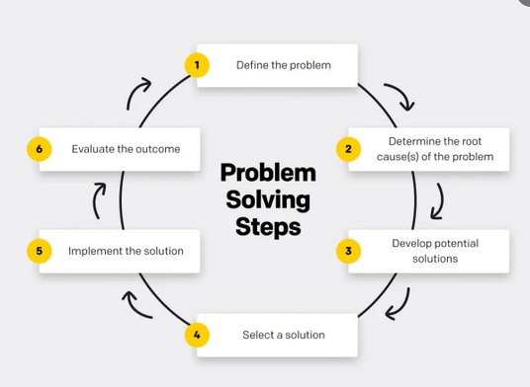
6 steps of Problem Solving

Slide 4
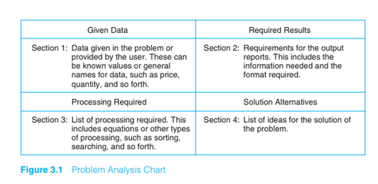
Problem Analysis Chart

Slide 5
Home Work
Calculating area of a circle
Converting marks to percentage

Slide 6
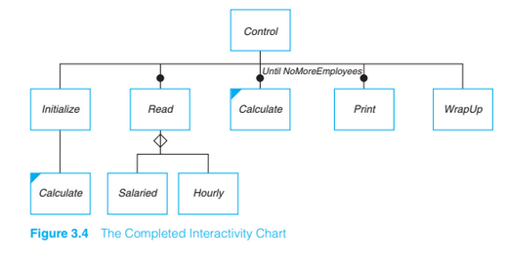
Interactivity Chart

Slide 7
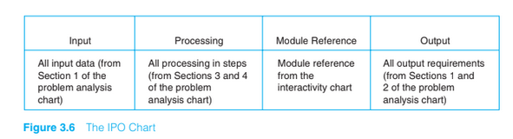
IPO Chart

Slide 8
Problem
Write a PAC, IC and IPO chart that asks a user to enter the distance of a trip in miles, the miles per gallon estimate for the user’s car, and the average cost of a gallon of gas. Calculate and display the number of gallons of gas needed and the estimated cost of the trip.

Slide 9
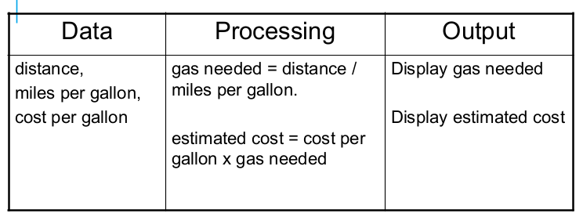
PAC

Slide 10
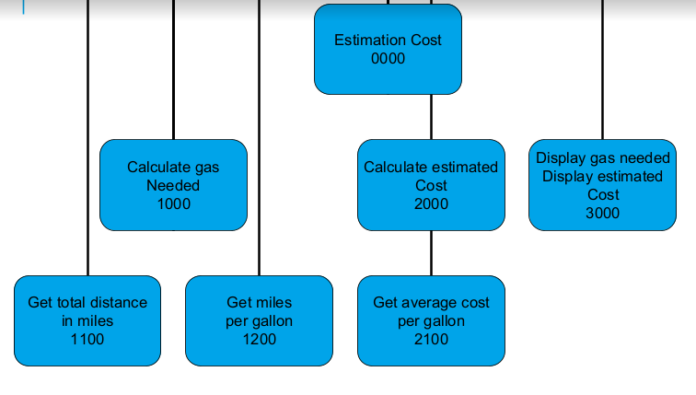
IC

Slide 11
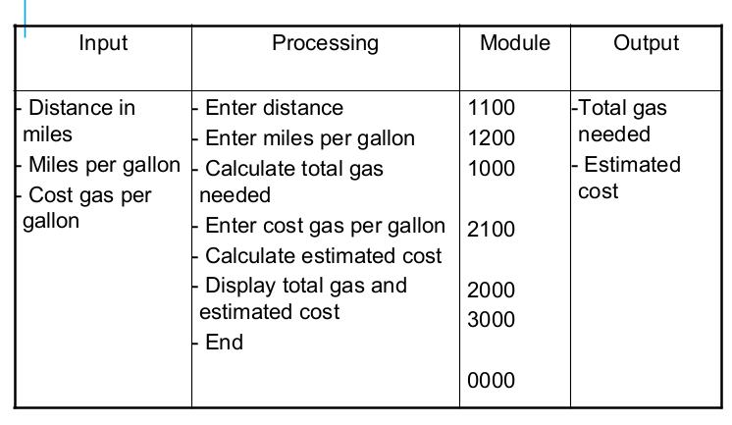
IPO Chart

Slide 12
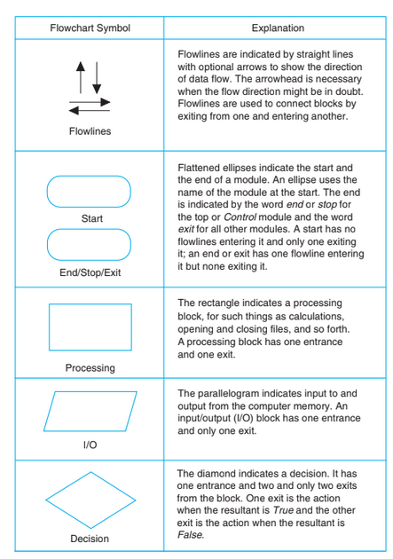
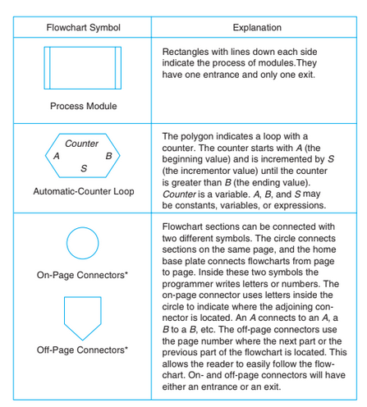
Flow Chart

Slide 13
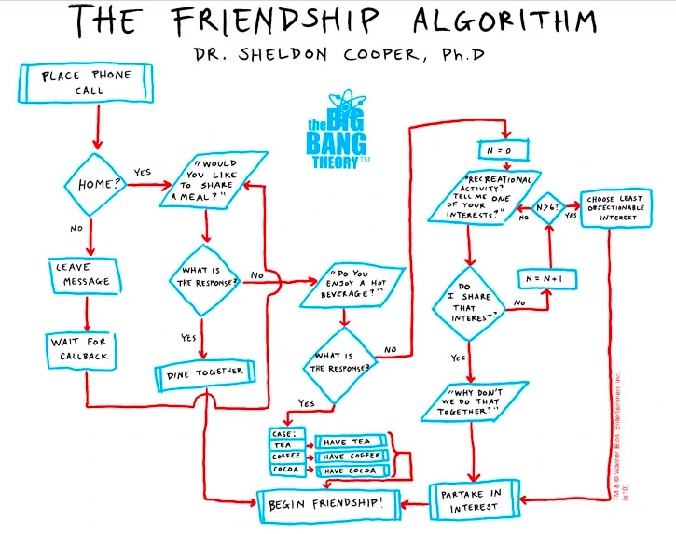
Friendship Algorithm

Slide 14
Problem
Make a flowchart to keep delaying your homework and spending your free time scrolling Facebook, or watching your favourite seasons, and whatever you want.

Slide 15
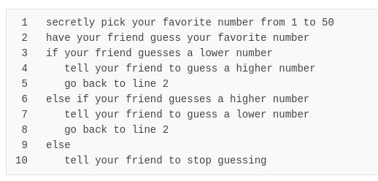
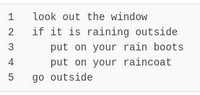
Pseudocode ~ Fake-code

Slide 16
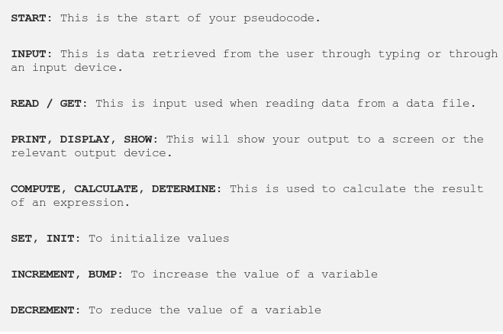
Pseudocode Keywords

Slide 17

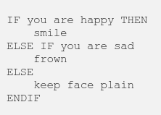
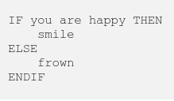
Conditional Statments

Slide 18
Pseudocode for adding two numbers
Start
PRINT “Please enter two numbers to add”
READ num1
READ num2
Sum = num1+num2
PRINT Sum
End

Slide 19
Problem
Draw a flowchart and write a pseudocode for a problem that to read two numbers. The first number represents the unit price of a product and the second number represents the quantity of the product sold. Calculate and print the total sale.

Slide 20
Problem
Draw a flowchart and write a pseudocode for a problem that asks a user to enter the distance of a trip in miles, the miles per gallon estimate for the user’s car, and the average cost of a gallon of gas. Calculate and display the number of gallons of gas needed and the estimated cost of the trip.

Slide 21
Home Assignment
Make PAC, IC, IPO, flowchart and write a pseudo code for all steps required to sign up Facebook.
Repeat everything for Facebook Login.

Slide 22
Home Assignment
Make PAC, IC, IPO, flowchart and write a pseudo code for all steps required to calculate ride cost for a person who wants to commute through Careem. Make necessary changes to accommodate different ride types.

